Slide 1
Computer Networks
Khizar Mukhtiar
Department of Computer Science
National University of Computer & Emerging Sciences

Slide 2
Recap
TCP

Slide 3
Congestion Control

Slide 4
What Is Congestion?
Congestion occurs when the number of packets being transmitted through the network approaches the packet handling capacity of the network
Congestion control aims to keep number of packets below level at which performance falls off dramatically
Generally, 80% utilization is critical

Slide 5
Effects of Congestion
Packets arriving are stored at input buffers and moved to output buffer as fast as possible.
If packets arrive too fast, buffer fills up and new packets will be discarded.
While network congestion is usually temporary, it can cause inconvenient network problems that can affect performance, such as packet loss, and latency, as well as a decrease in throughput.

Slide 6
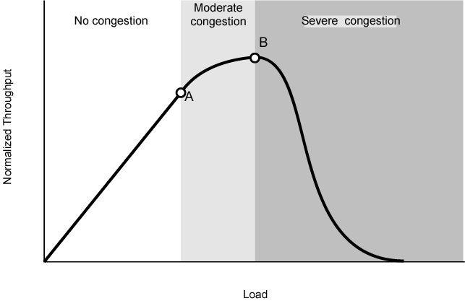
Practical Performance
Ideally, assume infinite buffers and no overhead
However, real buffers are finite
Overheads occur in exchanging congestion control messages

Slide 7
TCP Congestion Control: AIMD
Approach: senders can increase sending rate until packet loss (congestion) occurs, then decrease sending rate on loss event
Additive Increase
Multiplicative Decrease
  increase sending rate by 1 maximum segment size every RTT until loss detected
  cut sending rate in half at each loss event
AIMD sawtooth
behavior: probing
for bandwidth
TCP sender Sending rate
time

Slide 8
TCP Congestion Control
sender sequence number space
TCP sending behavior:
roughly: send cwnd bytes, wait RTT for ACKS, then send more bytes
cwnd
last byte
ACKed
cwnd
sent, but not-yet ACKed
(“in-flight”)
available but not used
TCP rate
~
bytes/sec
~
RTT
last byte sent
TCP sender limits transmission:
cwnd is dynamically adjusted in response to observed network congestion (implementing TCP congestion control)
<
cwnd
LastByteSent- LastByteAcked

Slide 9

TCP Slow Start
Host A
Host B
When connection begins, increase rate exponentially until first loss event:
  initially cwnd = 1 MSS
  double cwnd every RTT
  done by incrementing cwnd for every ACK received
one segment
RTT
two segments
four segments
Summary: initial rate is slow, but ramps up exponentially fast
time

